Slide 1
Disks

Slide 2
File System: Abstraction for Secondary Storage
CPU
Memory
Memory Bus
(System Bus)
Bridge
I/O Bus
Disk
NIC

Slide 3

Storage-Device Hierarchy

Slide 4
Secondary Storage
Secondary storage typically:
  Is storage outside of memory
  Does not permit direct execution of instructions or data retrieval via load/store instructions
Characteristics:
  It’s large: TB
  It’s cheap: $150-$200
  It’s persistent: data is maintained across process execution and power down (or loss)
  It’s slow: milliseconds to access

Slide 5
Disks
Seek time: time to move the disk head to the desired track
Rotational delay: time to reach desired sector once head is over the desired track
Transfer rate: rate data read/write to disk
Some typical parameters:
  Seek: ~8-10ms
  Rotational delay: ~4.15ms for 7200 rpm
  Transfer rate:
Sectors
Tracks

Slide 6

Moving-head Disk Machanism

Slide 7
Disk Scheduling
Disks are at least four orders of magnitude slower than the main memory
  The performance of disk I/O is vital for the performance of the computer system as a whole
  Access time (seek time+ rotational delay) >> transfer time for a sector
  Therefore the order in which sectors are read matters a lot
Disk scheduling
  Usually based on the position of the requested sector rather than according to the process priority
  Possibly reorder stream of read/write request to improve performance

Slide 8
Disk Scheduling (Cont.)
Several algorithms exist to schedule the servicing of disk I/O requests.
We illustrate them with a request queue (0-199).
98, 183, 37, 122, 14, 124, 65, 67
Head pointer 53

Slide 9

FCFS
Illustration shows total head movement of 640 cylinders.

Slide 10
SSTF
Selects the request with the minimum seek time from the current head position.
SSTF scheduling is a form of SJF scheduling; may cause starvation of some requests.
Illustration shows total head movement of 236 cylinders.

Slide 11

SSTF (Cont.)

Slide 12
SCAN
The disk arm starts at one end of the disk, and moves toward the other end, servicing requests until it gets to the other end of the disk, where the head movement is reversed and servicing continues.
Sometimes called the elevator algorithm.
Illustration shows total head movement of 208 cylinders.

Slide 13
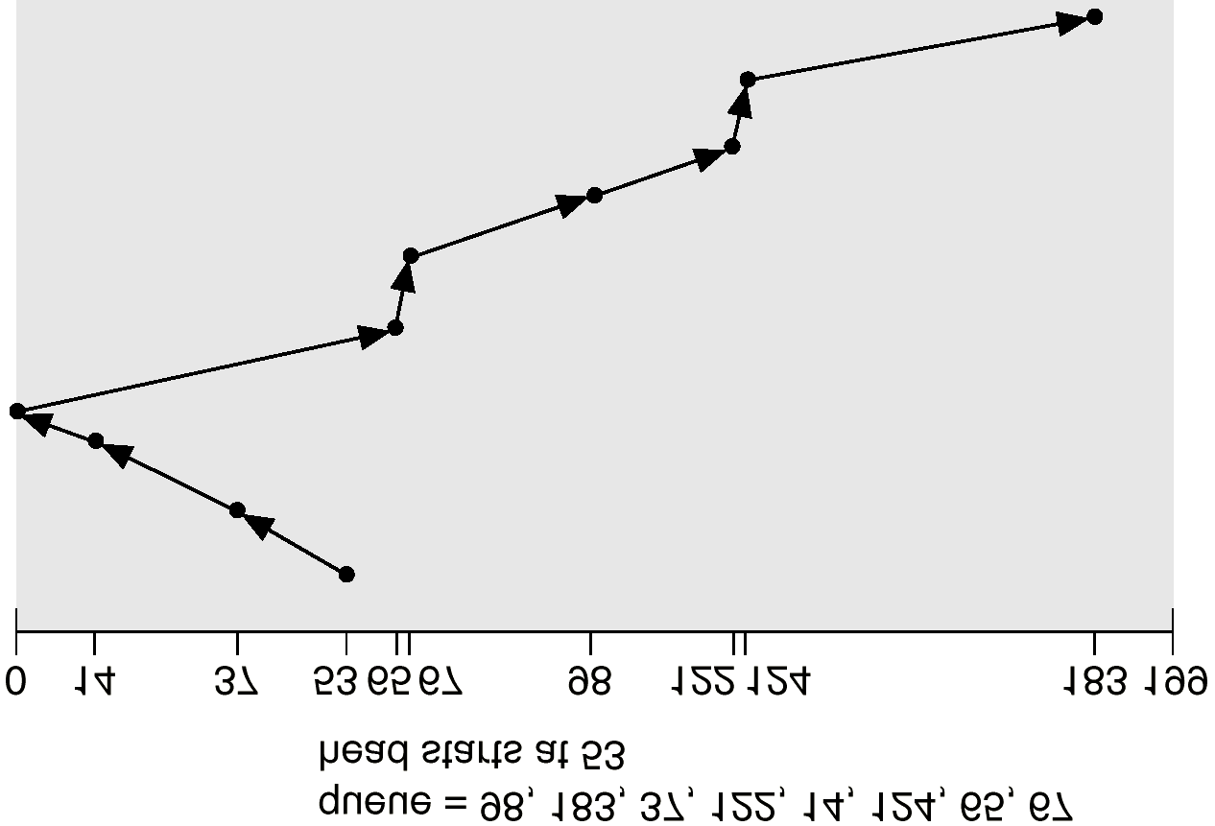
SCAN (Cont.)

Slide 14
C-SCAN
Provides a more uniform wait time than SCAN.
The head moves from one end of the disk to the other. servicing requests as it goes. When it reaches the other end, however, it immediately returns to the beginning of the disk, without servicing any requests on the return trip.
Treats the cylinders as a circular list that wraps around from the last cylinder to the first one.

Slide 15

C-SCAN (Cont.)

Slide 16
C-LOOK
Version of C-SCAN
Arm only goes as far as the last request in each direction, then reverses direction immediately, without first going all the way to the end of the disk.

Slide 17

C-LOOK (Cont.)

Slide 18
Selecting a Disk-Scheduling Algorithm
SSTF is common and has a natural appeal
SCAN and C-SCAN perform better for systems that place a heavy load on the disk.
Performance depends on the number and types of requests.
Requests for disk service can be influenced by the file-allocation method.
The disk-scheduling algorithm should be written as a separate module of the operating system, allowing it to be replaced with a different algorithm if necessary.
Either SSTF or LOOK is a reasonable choice for the default algorithm.

Slide 19
Disk Management
Low-level formatting, or physical formatting — Dividing a disk into sectors that the disk controller can read and write.
To use a disk to hold files, the operating system still needs to record its own data structures on the disk.
  Partition the disk into one or more groups of cylinders.
  Logical formatting or “making a file system”.
Boot block initializes system.
  The bootstrap is stored in ROM.
  Bootstrap loader program.
Methods such as sector sparing used to handle bad blocks.

Slide 20
Swap-Space Management
Swap-space — Virtual memory uses disk space as an extension of main memory.
Swap-space can be carved out of the normal file system,or, more commonly, it can be in a separate disk partition.
Swap-space management
  4.3BSD allocates swap space when process starts; holds text segment (the program) and data segment.
  Kernel uses swap maps to track swap-space use.
  Solaris 2 allocates swap space only when a page is forced out of physical memory, not when the virtual memory page is first created.

Slide 21
Disk Reliability
Several improvements in disk-use techniques involve the use of multiple disks working cooperatively.
RAID is one important technique currently in common use.

Slide 22
RAID
Redundant Array of Inexpensive Disks (RAID)
  A set of physical disk drives viewed by the OS as a single logical drive
  Replace large-capacity disks with multiple smaller-capacity drives to improve the I/O performance (at lower price)
  Data are distributed across physical drives in a way that enables simultaneous access to data from multiple drives
  Redundant disk capacity is used to compensate for the increase in the probability of failure due to multiple drives
    Improve availability because no single point of failure
Six levels of RAID representing different design alternatives

Slide 23
RAID Level 0
Does not include redundancy
Data is stripped across the available disks
  Total storage space across all disks are divided into strips
  Strips are mapped round-robin to consecutive disks
  A set of consecutive strips that map exactly one strip to each disk in the array is called a stripe
Can you see how this improves the disk I/O bandwidth?
What access pattern gives the best performance?
stripe 0
strip 0
strip 1
strip 2
strip 3
strip 4
strip 5
strip 6
strip 7
...

Slide 24
RAID Level 1
Redundancy achieved by duplicating all the data
Every disk has a mirror disk that stores exactly the same data
  A read can be serviced by either of the two disks which contains the requested data (improved performance over RAID 0 if reads dominate)
  A write request must be done on both disks but can be done in parallel
  Recovery is simple but cost is high
strip 0
strip 0
strip 1
strip 1
strip 2
strip 2
strip 3
strip 3
...

Slide 25
RAID Levels 2 and 3
Parallel access: all disks participate in every I/O request
Small strips since size of each read/write = # of disks * strip size
RAID 2: error correcting code is calculated across corresponding bits on each data disk and stored on log(# data disks) parity disks
  Hamming code: can correct single-bit errors and detect double-bit errors
  Less expensive than RAID 1 but still pretty high overhead – not really needed in most reasonable environments
RAID 3: a single redundant disk that keeps parity bits
  P(i) = X2(i) ⊕ X1(i) ⊕ X0(i)
In the event of a failure, data can be reconstructed
  Can only tolerate a single failure at a time
b0
b1
b2
P(b)
X2(i) = P(i) ⊕ X1(i) ⊕ X0(i)

Slide 26


Parity Codes
Single Bit Parity:
Detect single bit errors
Two Dimensional Bit Parity:
Detect and correct single bit errors
0
0

Slide 27
RAID Levels 4 and 5
RAID 4
  Large strips with a parity strip like RAID 3
  Independent access - each disk operates independently, so multiple I/O request can be satisfied in parallel
  Independent access  small write = 2 reads + 2 writes
  Example: if write performed only on strip 0:
    P’(i) = X2(i) ⊕ X1(i) ⊕ X0’1(i)
    = X2(i) ⊕ X1(i) ⊕ X0’(i) ⊕ X0(i) ⊕ X0(i)
    = P(i) ⊕ X0’(i) ⊕ X0(i)
  Parity disk can become bottleneck
RAID 5
  Like RAID 4 but parity strips are distributed across all disks
strip 0
strip 1
strip 2
P(0-2)
strip 3
strip 4
strip 5
P(3-5)

Slide 28
Calculating a Hamming Code
Procedure:
  Place message bits in their non-power-of-two Hamming positions
  Build a table listing the binary representation each each of the message bit positions
  Calculate the check bits

Slide 29
Hamming Code Example
Message to be sent:
1 0 1 1
1 0 1 1
1 2 3 4 5 6 7
2⁰ 2¹ 2²
Position
2^{n}: check bits

Slide 30
Hamming Code Example
Message to be sent:
1 0 1 1
1 0 1 1
1 2 3 4 5 6 7
2⁰ 2¹ 2²
Position
2^{n}: check bits
Calculate check bits:
3 = 2¹ + 2⁰ = 0 1 1
5 = 2² + 2⁰ = 1 0 1
6 = 2² + 2¹ + = 1 1 0
7 = 2² + 2¹ + 2⁰ = 1 1 1

Slide 31
Hamming Code Example
Message to be sent:
1 0 1 1
1 0 1 1
1 2 3 4 5 6 7
2⁰ 2¹ 2²
1
Starting with the 2⁰ position:
Look at positions with 1’s
in them
Count the number of 1’s in the
corresponding message bits
If even, place a 1 in the 2⁰
check bit, i.e., use odd parity
Otherwise, place a 0
Position
2^{n}: check bits
Calculate check bits:
3 = 2¹ + 2⁰ = 0 1 1
5 = 2² + 2⁰ = 1 0 1
6 = 2² + 2¹ + = 1 1 0
7 = 2² + 2¹ + 2⁰ = 1 1 1
Notes:
Base on 3-5-7 to find the value of 2^0, assume using odd parity

Slide 32
Hamming Code Example
Message to be sent:
1 0 1 1
1 0 1 1
1 2 3 4 5 6 7
2⁰ 2¹ 2²
1
0
Repeat with the 2¹ position:
Look at positions those
positions with 1’s in them
Count the number of 1’s in the
corresponding message bits
If even, place a 1 in the 2¹
check bit
Otherwise, place a 0
Position
2^{n}: check bits
Calculate check bits:
3 = 2¹ + 2⁰ = 0 1 1
5 = 2² + 2⁰ = 1 0 1
6 = 2² + 2¹ + = 1 1 0
7 = 2² + 2¹ + 2⁰ = 1 1 1
Notes:
Base on 3-6-7 to find the parity bit value

Slide 33
Hamming Code Example
Message to be sent:
1 0 1 1
1 0 1 1
1 2 3 4 5 6 7
2⁰ 2¹ 2²
1
0
1
Repeat with the 2² position:
Look at positions those
positions with 1’s in them
Count the number of 1’s in the
corresponding message bits
If even, place a 1 in the 2²
check bit
Otherwise, place a 0
Position
2^{n}: check bits
Calculate check bits:
3 = 2¹ + 2⁰ = 0 1 1
5 = 2² + 2⁰ = 1 0 1
6 = 2² + 2¹ + = 1 1 0
7 = 2² + 2¹ + 2⁰ = 1 1 1

Slide 34
Hamming Code Example
Original message = 1011
Sent message = 1011011
Now, how do we check for a single-bit error in the sent message using the Hamming code?

Slide 35
Using Hamming Codes to Correct Single-Bit Errors
Received message:
1 0 1 1 0 0 1
1 0 1 1 0 0 1
1 2 3 4 5 6 7
2⁰ 2¹ 2²
Position
2^{n}: check bits
Calculate check bits:
3 = 2¹ + 2⁰ = 0 1 1
5 = 2² + 2⁰ = 1 0 1
6 = 2² + 2¹ = 1 1 0
7 = 2² + 2¹ + 2⁰ = 1 1 1

Slide 36
Using Hamming Codes to Correct Single-Bit Errors
Received message:
1 0 1 1 0 0 1
1 0 1 1 0 0 1
1 2 3 4 5 6 7
2⁰ 2¹ 2²
Starting with the 2⁰ position:
Look at positions with 1’s
in them
Count the number of 1’s in
both the corresponding
message bits and the 2⁰ check
bit and compute the parity.
If even parity, there is an error
in one of the four bits that were
checked.
Position
2^{n}: check bits
Calculate check bits:
3 = 2¹ + 2⁰ = 0 1 1
5 = 2² + 2⁰ = 1 0 1
6 = 2² + 2¹ = 1 1 0
7 = 2² + 2¹ + 2⁰ = 1 1 1
Odd parity: No error in bits 1, 3, 5, 7

Slide 37
Using Hamming Codes to Correct Single-Bit Errors
Received message:
1 0 1 1 0 0 1
1 0 1 1 0 0 1
1 2 3 4 5 6 7
2⁰ 2¹ 2²
Repeat with the 2¹ position:
Look at positions with 1’s
in them
Count the number of 1’s in
both the corresponding
message bits and the 2¹ check
bit and compute the parity.
If even parity, there is an error
in one of the four bits that were
checked.
Position
2^{n}: check bits
Calculate check bits:
3 = 2¹ + 2⁰ = 0 1 1
5 = 2² + 2⁰ = 1 0 1
6 = 2² + 2¹ = 1 1 0
7 = 2² + 2¹ + 2⁰ = 1 1 1
Even parity: ERROR in bit 2, 3, 6 or 7!

Slide 38
Using Hamming Codes to Correct Single-Bit Errors
Received message:
1 0 1 1 0 0 1
1 0 1 1 0 0 1
1 2 3 4 5 6 7
2⁰ 2¹ 2²
Repeat with the 2² position:
Look at positions with 1’s
in them
Count the number of 1’s in
both the corresponding
message bits and the 2² check
bit and compute the parity.
If even parity, there is an error
in one of the four bits that were
checked.
Position
2^{n}: check bits
Calculate check bits:
3 = 2¹ + 2⁰ = 0 1 1
5 = 2² + 2⁰ = 1 0 1
6 = 2² + 2¹ = 1 1 0
7 = 2² + 2¹ + 2⁰ = 1 1 1
Even parity: ERROR in bit 4, 5, 6 or 7!

Slide 39
Finding the error’s location
1 0 1 1 0 0 1
1 2 3 4 5 6 7
Position

Slide 40
Finding the error’s location
1 0 1 1 0 0 1
1 2 3 4 5 6 7
Position
No error in bits 1, 3, 5, 7

Slide 41
Finding the error’s location
erroneous bit, change to 1
1 0 1 1 0 0 1
1 2 3 4 5 6 7
Position
Error must be in bit 6
because bits 3, 5, 7
are correct, and all the
remaining information
agrees on bit 6
ERROR in bit 2, 3, 6 or 7
ERROR in bit 4, 5, 6 or 7

Slide 42
Finding the error’s location
An Easier Alternative to the Last Slides
3 = 2¹ + 2⁰ = 0 1 1
5 = 2² + 2⁰ = 1 0 1
6 = 2² + 2¹ = 1 1 0
7 = 2² + 2¹ + 2⁰ = 1 1 1
E
E
NE
1
1
0
= 6
E = error in column
NE = no error in column

Slide 43
Hamming Codes
Hamming codes can be used to locate and correct a single-bit error
If more than one bit is in error, then a Hamming code cannot correct it
Hamming codes, like parity bits, are only useful on short messages

